Slide 1
Cloudstack을 활용한
코딩 교육 지원환경 개발
Team: 바다
Team members:
Kamila Makhmudova 201724633
강다미 201645801
김동환 201324416

Slide 2




Table Of Content
Content
Reason and Motivation
Reasons and motivation of developing the project
Project Goal
Goal of the project
System Structure
Brief explanation of system structure
Result
Result of the project including visual support
Uniqueness
What is unique about the project and what makes it different
Limits and future improvements
Limitations and suggestions for further development
Conclusion
Sum up of the project

Slide 3


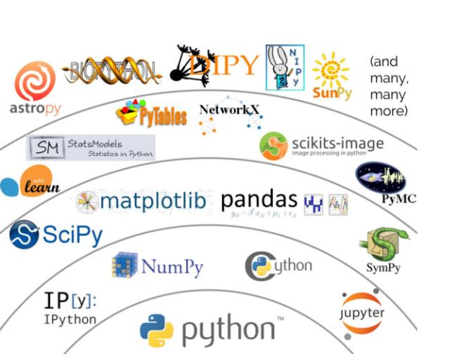
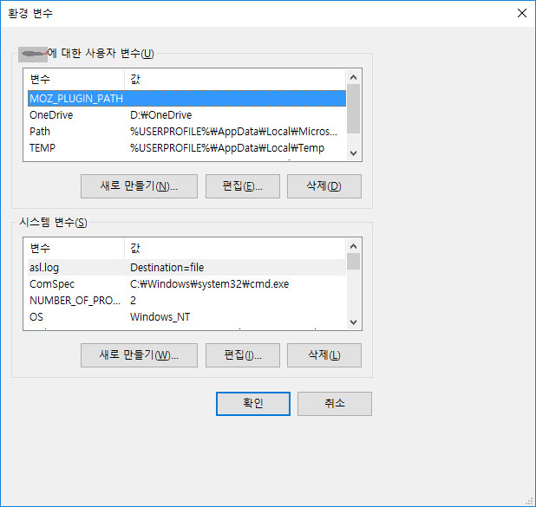




Reason and Motivation

Slide 4
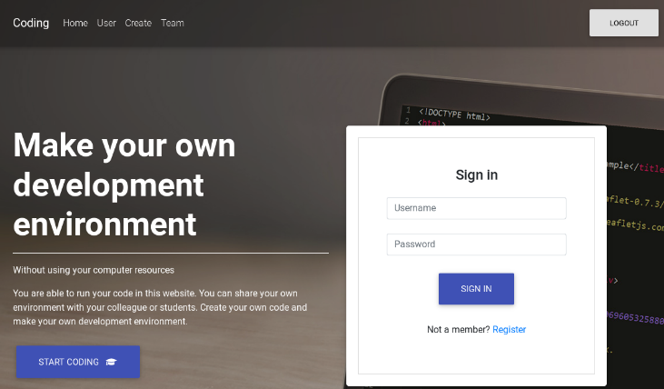
Reason and Motivation
I want to study coding
coding.com

Slide 5



Project Goal
01
02
03
시스템 환경에 제약이 덜한 웹 기반 코딩 실습환경 제공
다수에게 동일한 개발환경 제공
개발에 필요한 클라우드 자원 제공

Slide 6
CloudStack
Infrastructure as a Service (IaaS)
User Interface
Instances
Virtual Machines
Infrastructure

Slide 7
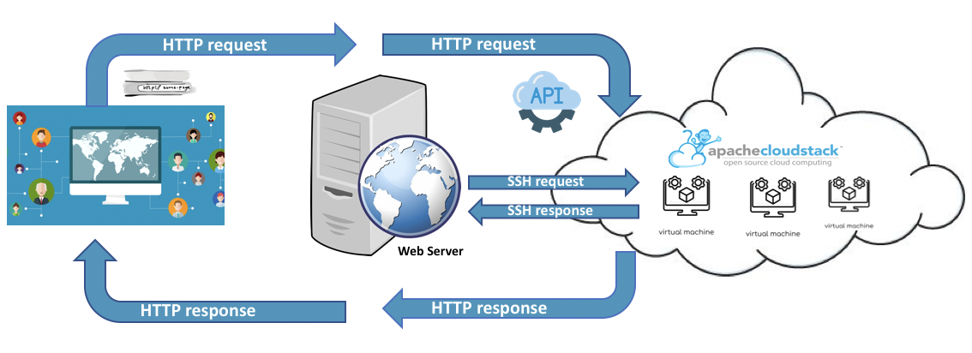
System Structure
① 사용자의 요청을 웹서버에 전송
② 웹서버의 요청을 CloudStack API를 통해 전송
③ 사용자 파일 처리 요청
④ 처리결과 전송
⑥ 결과를 사용자 화면에 출력
⑤ CloudStack API 요청 처리 결과 전송

Slide 8
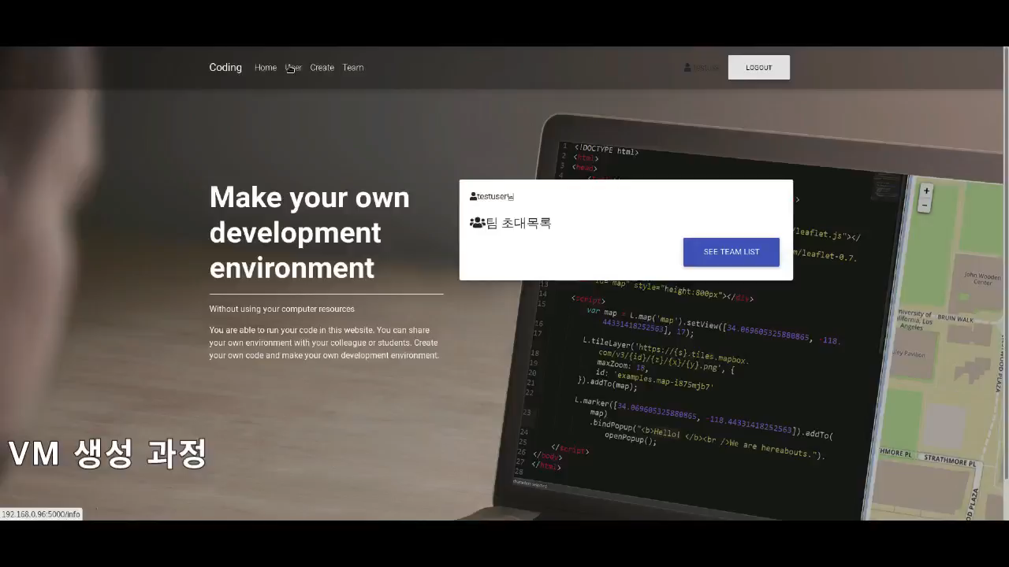
Demo video

Slide 9
Result: key-features
Customizing
Coding
Teaming
Preference
Personalization
Comfort
Anywhere
Fast
Convenient
Anytime
Anywhere
Anyone

Slide 10










Customizing
OS
Disk
Language
CPU
templates

Slide 11
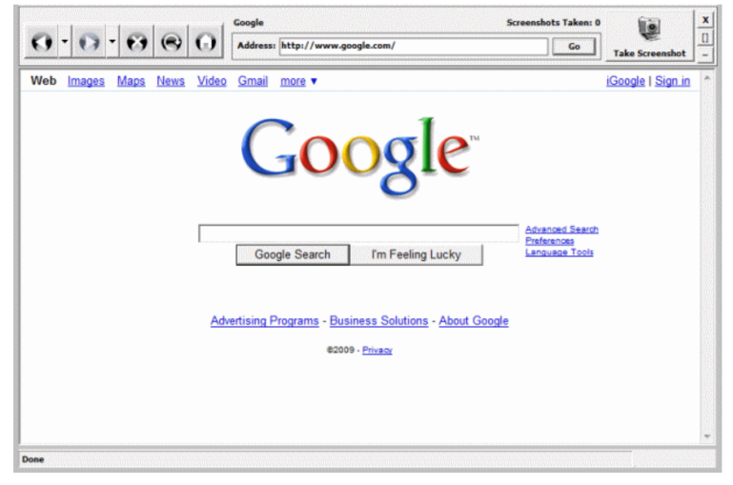

Customizing
templates

Slide 12
Coding
SSH Request
result
SSH Response
code
Hello World!
printf(“Hello World!”);

Slide 13
Uniqueness: Collaboration with team online

Slide 14





Uniqueness: Team

Slide 15



Limitations and Future Improvement
Variety
Modification
and Flexibility
Distribution
IDE

Slide 16




Conclusion
Web Environment
Setting
Share
You can code on
web environment
You do not need to set up you own environment for coding.
You can share your code with your friends

Slide 17
Thank you for your attention

Slide 18
References
https://cloudstack.apache.org/
https://cloudstack.apache.org/about.html
https://www.wikipedia.org/
https://cloudstack.apache.org/api/apidocs-4.11/
https://www.flaticon.com/?utm_term=flat%20icon&utm_campaign=fi_busqueda-korea&utm_source=adwords&utm_medium=ppc&hsa_acc=5490559948&hsa_cam=1678088545&hsa_grp=68164273913&hsa_ad=331720832859&hsa_src=g&hsa_tgt=kwd-327306969284&hsa_kw=flat%20icon&hsa_mt=b&hsa_net=adwords&hsa_ver=3&gclid=Cj0KCQiA2ITuBRDkARIsAMK9Q7OFbjy8ka46qRP1pAOrTxTvhL0opMbrjvL-B9_5-MvLm4U4hdtuikEaAg_cEALw_wcB

